Slide 1

MIME (Multipurpose Internet Mail Extension)
: a supplementary protocol that allows non-ASCII code
to be sent through SMTP (extension to SMTP)
user
user
Non-ASCII code
Non-ASCII code
MIME
MIME
ASCII code
ASCII code
ASCII code
SMTP
SMTP

Slide 2
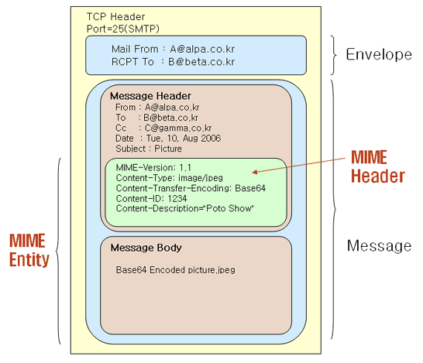
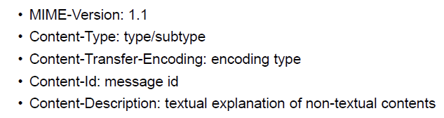
MIME header

Slide 3
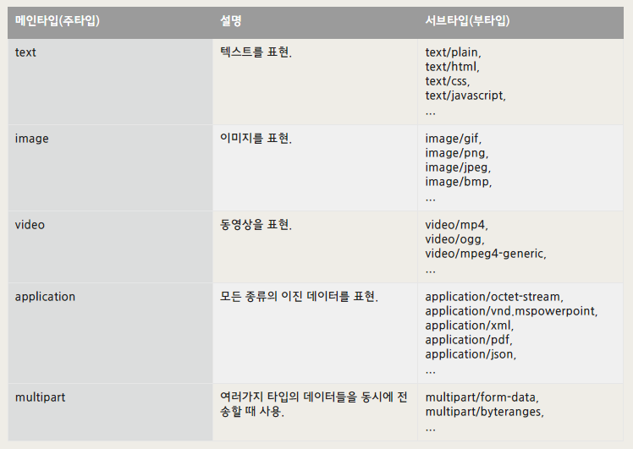
Content-Type: type/subtype

Slide 4
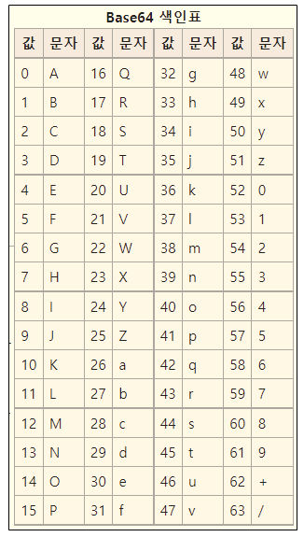
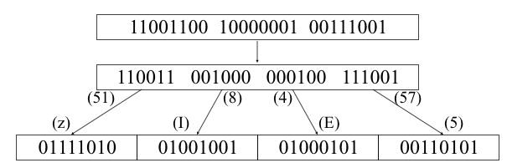
Base64 table
Content-Transfer-Encoding: Base64
Example)
24-bit non-ASCII data
4 X 6-bit data
ASCII coded data

Slide 5
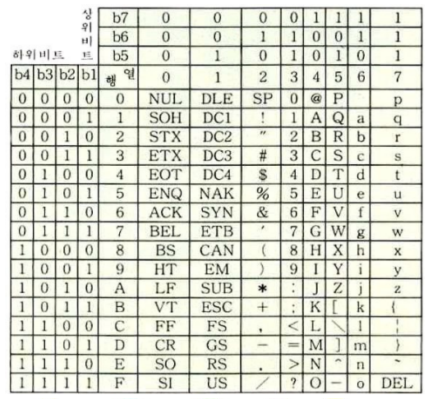
ASCII code table
Base64 table

